Slide 1
Mobile Application Development
Lecture 13

Slide 2
Loading Asynchronous data in Ionic
Uptil now, we have been using static data which has always been there and we were always able to see the data very quickly like those list of students (55).
What if that list of students was sent from IIUI’s database? From their server which we dont know where its located. In that case, loading that will take time. Maybe less than 1 second. Maybe upto 5 seconds depending on the network/speed of internet.
Notes:
First of all, we need to understand what Parent, Child, and Sibling components are.

Slide 3
Loading Asynchronous data in Ionic
In order to load the data from a server, we would use a REST API. We would use a GET request that would retrieve us that data. Getting data from a server is usually done via HTTP requests to that URL.
In our first example, we will display quotes from an API which is hosted at random-quotes.now.sh
Notes:
First of all, we need to understand what Parent, Child, and Sibling components are.

Slide 4
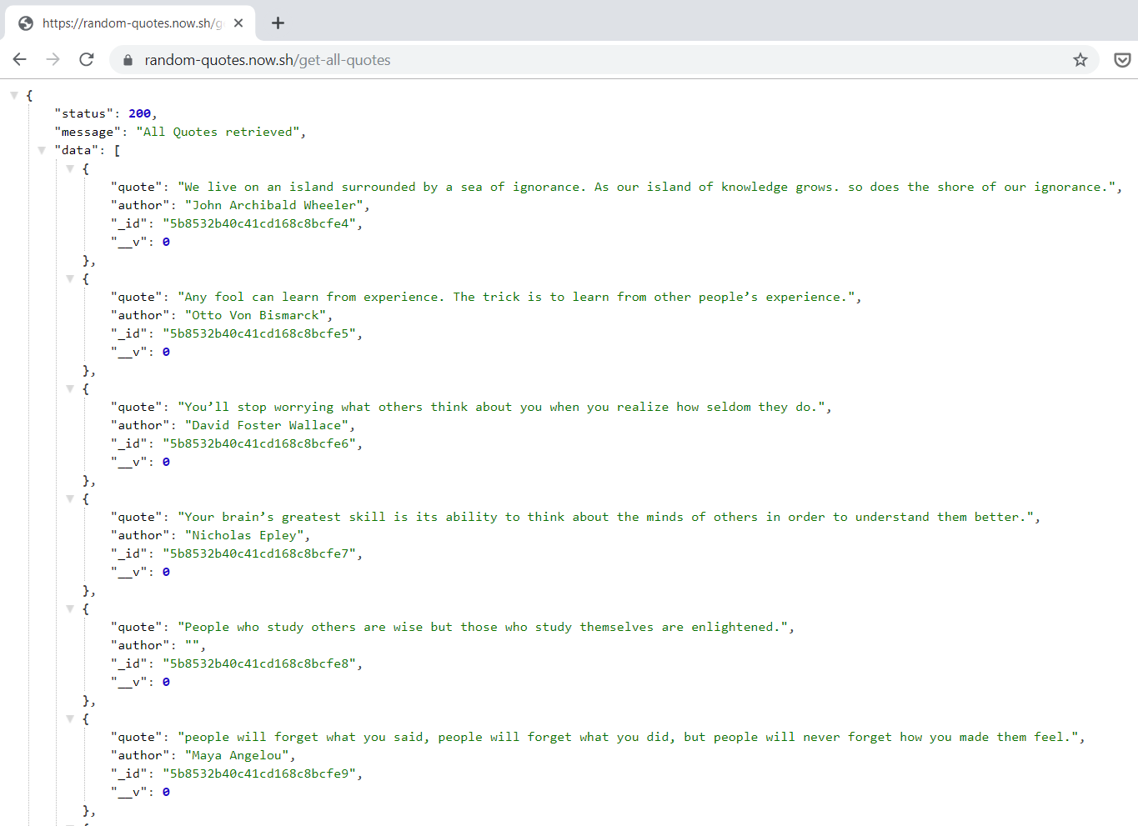
Loading Asynchronous data in Ionic
When ever we have to load data, remember we need a Service. In the service, we make fetch data in an angular/ionic application.
Opening https://random-quotes.now.sh/get-all-quotes in browser
Lets display it in our app
Notes:
First of all, we need to understand what Parent, Child, and Sibling components are.

Slide 5
Loading Asynchronous data in Ionic
For making HTTP Requests, Angular provides an HttpClientModule which we need to import in our app module.
We will be writing the API call code in our Service, so lets create a service with name data-listings.
Notes:
First of all, we need to understand what Parent, Child, and Sibling components are.

Slide 6
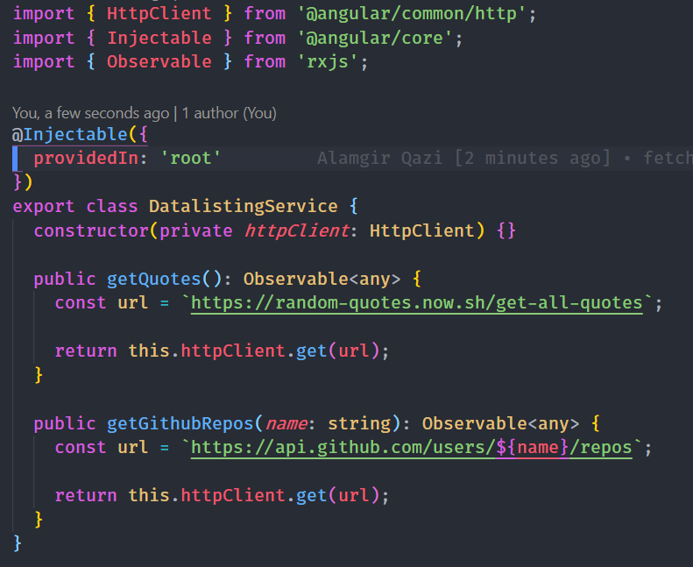
Loading Asynchronous data in Ionic
Here is how our service file looks like.
We use Angular’s built-in HTTP module instead of using something like Fetch/Axios to make the GET request.
Notes:
First of all, we need to understand what Parent, Child, and Sibling components are.

Slide 7
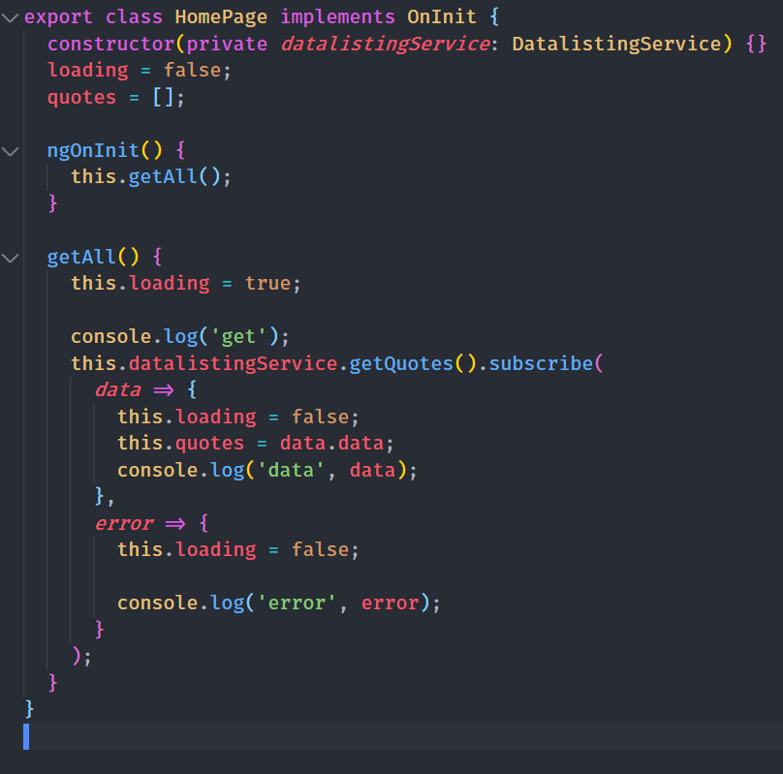
Loading Asynchronous data in Ionic
Here is how the component file looks like.
Since from our service, we return an Observable, here we have to subscribe. We get the data and we store it in quotes array which we display using *ngFor
Notes:
First of all, we need to understand what Parent, Child, and Sibling components are.

Slide 8


Slide 9
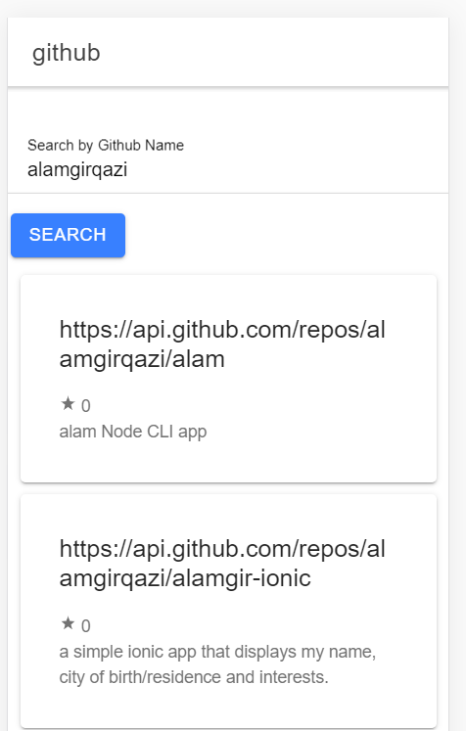
Loading Asynchronous data in Ionic
Lets take the example a little further and make it more real. This time, we will search repositories of github users by using Github API.
We will make an API call when the user clicks on Search button
Notes:
First of all, we need to understand what Parent, Child, and Sibling components are.

Slide 10
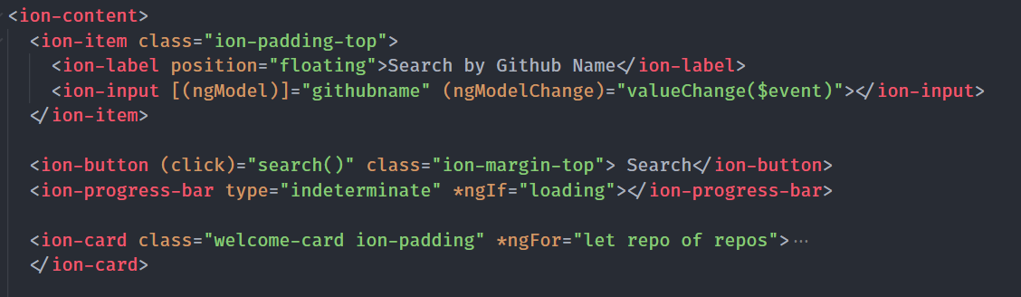
Loading Asynchronous data in Ionic
Here is what the html looks like.
We have binded githubname with the input using Angular’s two-way binding
Notes:
First of all, we need to understand what Parent, Child, and Sibling components are.

Slide 11
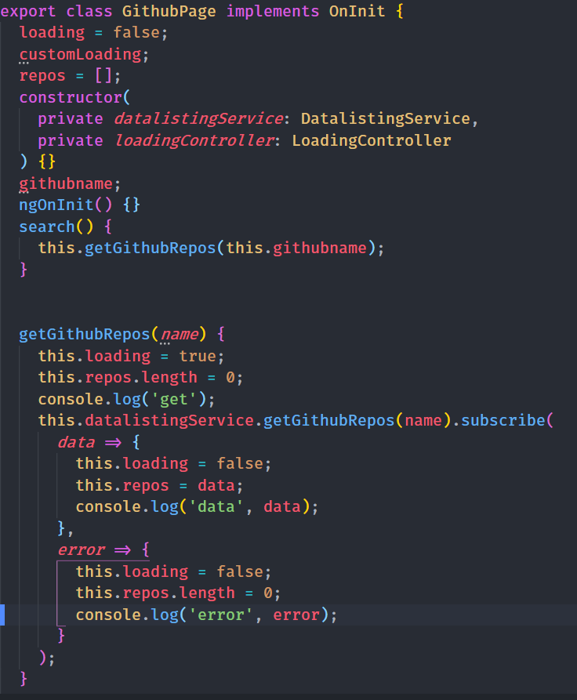
Loading Asynchronous data in Ionic
Here is what the typescript file looks like.
Whenever the search button is clicked, the search() method is called which sends the name to the service. And once the data returns we display it. Here we use loading variable to know whether our data has loaded or not. This helps us display a loader.
Notes:
First of all, we need to understand what Parent, Child, and Sibling components are.

Slide 12
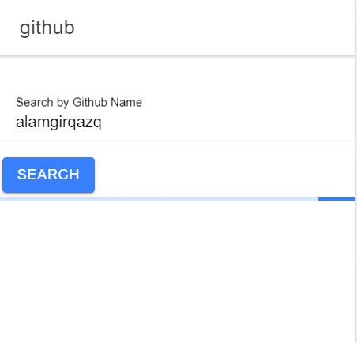
Loading Asynchronous data in Ionic
We can use different types of loaders.
Ionic provides , ion-spinner, ion-loading, <ion-skeleton-text>, <ion-progress-bar> like the one on the right etc.
Use loaders which enhance the user experience (UX)
Notes:
First of all, we need to understand what Parent, Child, and Sibling components are.

